Slide 1

Sky Scan
Accessibility to Fresh Air-A map Based Solution
By: Andrew M, Srihith Chennareddy Jeffrey Wong

Slide 2
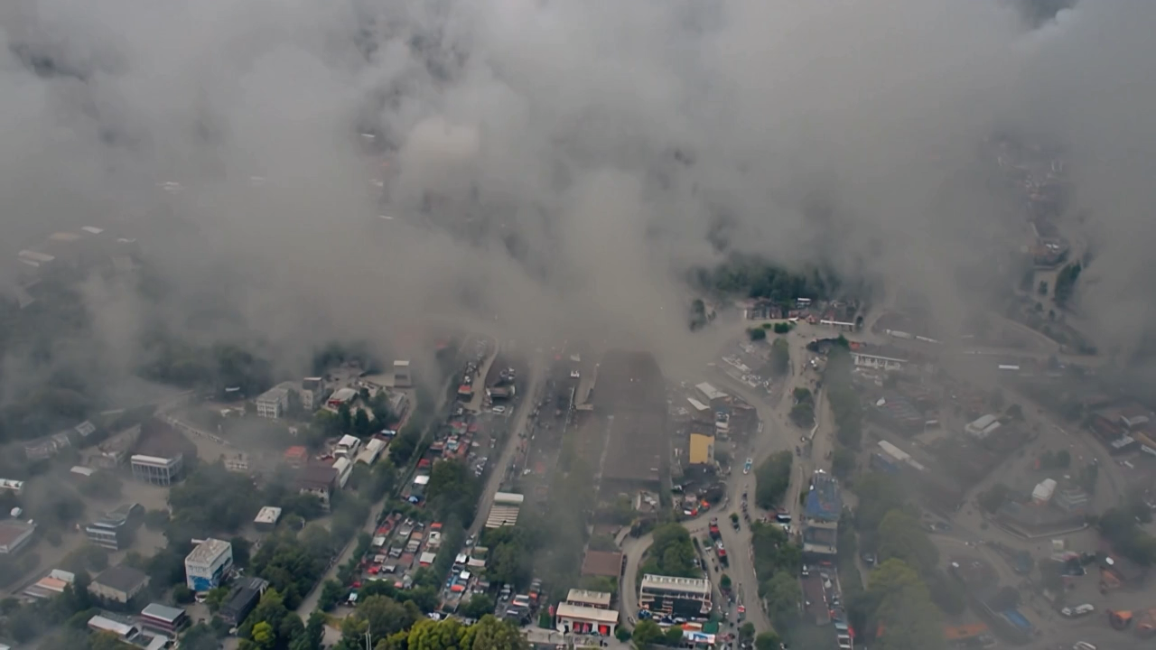
The Problem:
Air pollution, leads to severe health risks such as respiratory diseases, heart conditions, and even death. The WHO says 7 million people die due to poor air quality annually.
Poor air quality disproportionately affects vulnerable populations, such as children, the elderly, low-income communities and individuals with pre-existing heart and lung disease
In the US, according to the American Lund Association 40% live in places with unhealthy levels of air pollution. Globally billion of people suffer from dangerous air pollution according to the World Health Organization.
Notes:
Urban areas around the world are experiencing increasing levels of air pollution, leading to severe health risks such as respiratory diseases, heart conditions, and even death
Poor air quality disproportionately affects vulnerable populations, including children, the elderly, and low-income communities
Around 40% in the US are living in places with unhealthy levels of polluted air, according to a new report from the American Lung Association

Slide 3
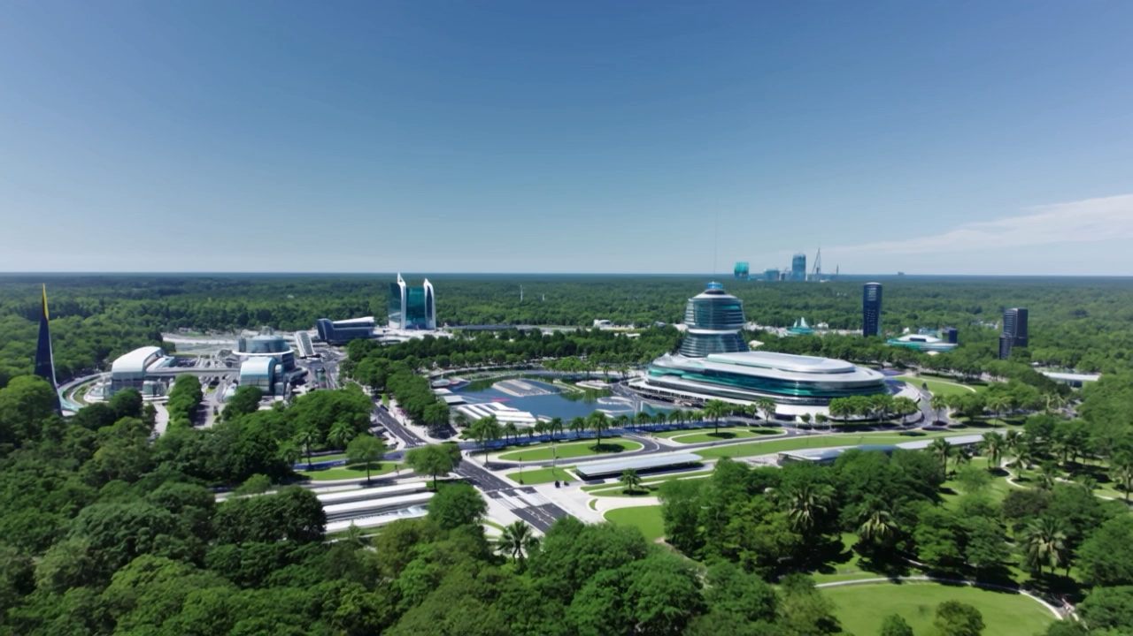
Our Mission Statement
Enhancing Urban Accessibility by addressing air quality challenges.
Providing Real-Time Solutions for monitoring and improving air environments.
Leveraging Advanced Technology & Data to generate actionable insights.
Notes:
Our mission is to enhance urban accessibility by tackling the critical issue of air quality. We aim to provide innovative, real-time solutions that help communities monitor and improve their air environment. By combining advanced technology with data-driven insights, we empower citizens, local governments, and organizations to take action, reduce pollution, and foster healthier, more sustainable cities. Through this, we aspire to create an inclusive urban future where everyone can breathe cleaner air and live healthier lives.

Slide 4



Our Solution:
Using React Library, JavaScript, and multiple API’s we’ve created a website that allows:
users to input a specific radius into a map and find all available good air quality sources within that area
Key Information about Air Quality, its impacts and how to protect yourself.
Algorithm that calculates Air Quality risk factor to go outside

Slide 5

How It Works:
Users simply enter their location and the radius within which they want to search for good air quality sources. The map dynamically updates to show available sources, with information such as whether the air quality source is good/unhealthy and the distance to each point. Users can zoom in or out to adjust the map and search for a specific location.

Slide 6

Real-World Applications:
Using real-time air quality data, users monitor pollution levels and make informed decisions about their outdoor activities, especially in areas where air quality may be a concern. It is especially useful for children or elderly individuals as it calculates a risk factor score for them to go outside.

Slide 7

Future Development:
Integrate crowdsourced data for more accurate and up-to-date air quality information
Enable real-time user contributions to improve data accuracy and coverage
Implement air quality alerts for hazardous pollution levels
Provide evacuation suggestions based on air quality data
Enhance app responsiveness and functionality to improve user safety
Notes:
The next steps for SkyScan involve integrating crowdsourced data to provide more accurate and up-to-date information about air quality events locally and globally. This will further enhance real-time user contributions to make improve the app's data accuracy and coverage. Additionally, we plan to implement air quality alerts, notifying users when pollution levels are dangerously high in their location. The app will also suggest safe areas to evacuate to, based on air quality data, ensuring users can take timely action to protect their health. These updates will improve the app's responsiveness and make it a more vital tool for air quality monitoring and safety.

Slide 8
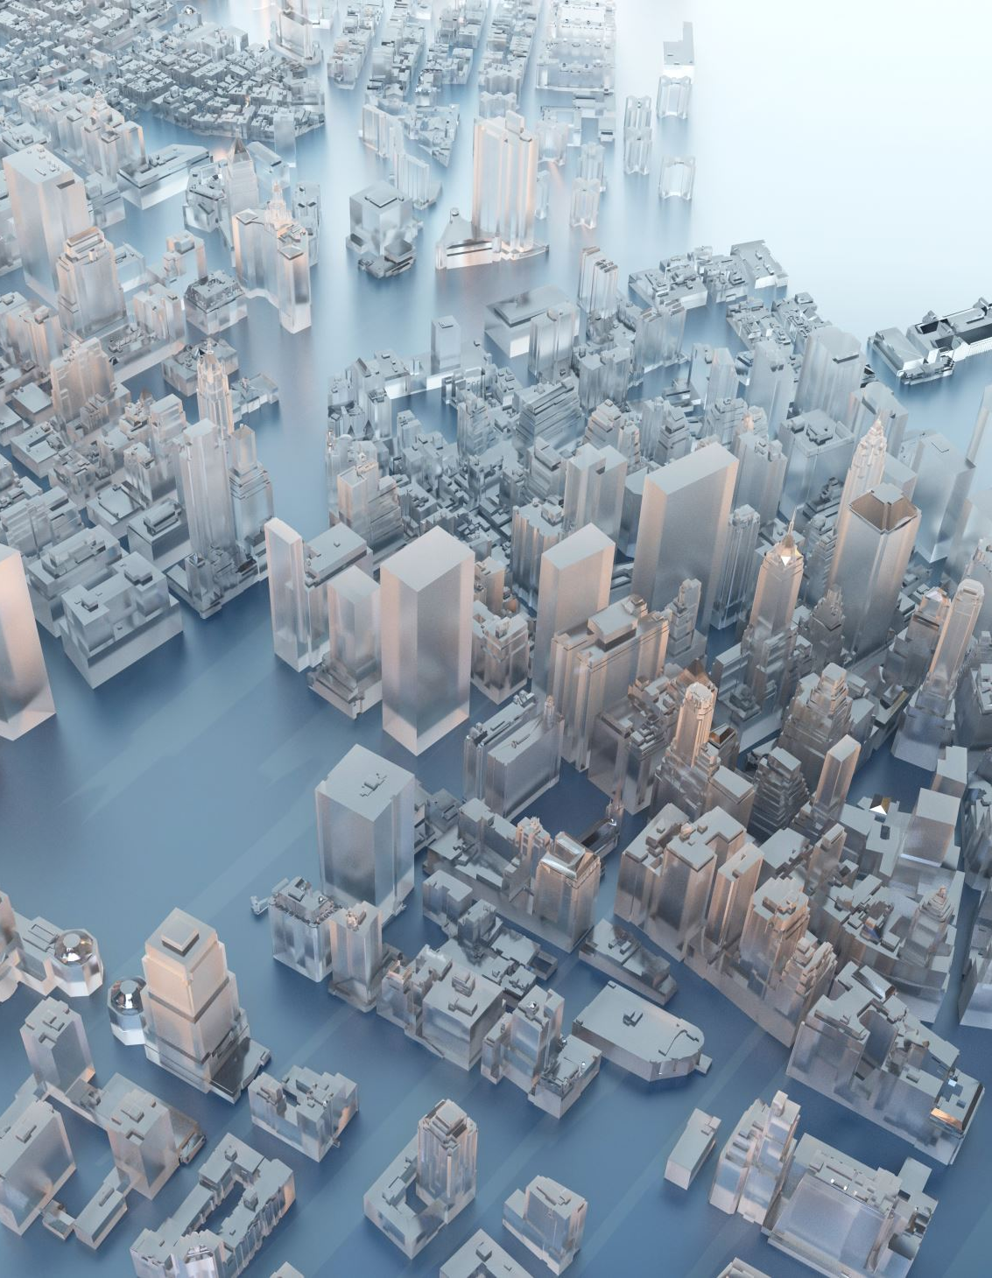
Conclusion:
Air quality is one of the biggest challenges in creating accessible and livable urban environments. Our solution not only monitors and analyzes air quality but also empowers communities to take action. Together, we can pave the way for healthier, more sustainable cities in the future.

